Slide 1
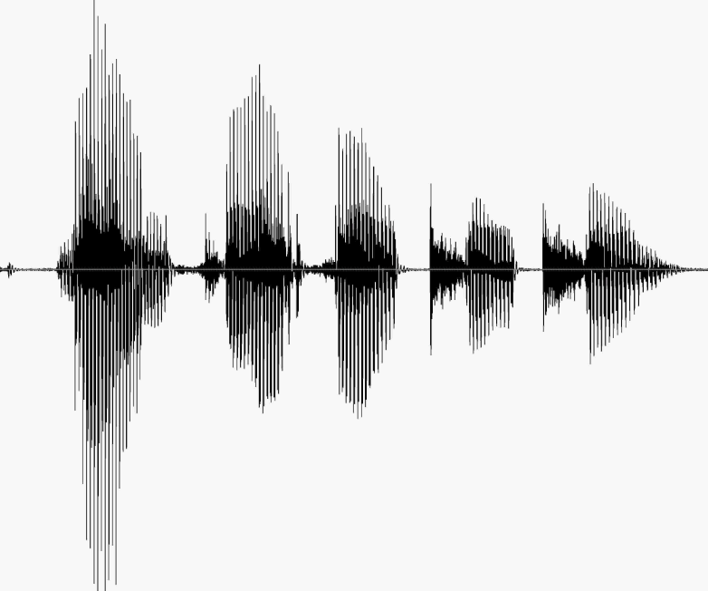
CS 224S / LINGUIST 285 Spoken Language Processing
Andrew Maas
Stanford University
Spring 2017
Lecture 3: ASR: HMMs, Forward, Viterbi
Original slides by Dan Jurafsky

Slide 2

Fun informative read on phonetics
The Art of Language Invention. David J. Peterson. 2015.
http://www.artoflanguageinvention.com/books/

Slide 3
Outline for Today
ASR Architecture
Decoding with HMMs
Forward
Viterbi Decoding
How this fits into the ASR component of course
On your own: N-grams and Language Modeling
Apr 12: Training, Advanced Decoding
Apr 17: Feature Extraction, GMM Acoustic Modeling
Apr 24: Neural Network Acoustic Models
May 1: End to end neural network speech recognition

Slide 4
The Noisy Channel Model
Search through space of all possible sentences.
Pick the one that is most probable given the waveform.

Slide 5
The Noisy Channel Model (II)
What is the most likely sentence out of all sentences in the language L given some acoustic input O?
Treat acoustic input O as sequence of individual observations
O = o₁,o₂,o₃,…,o_{t}
Define a sentence as a sequence of words:
W = w₁,w₂,w₃,…,w_{n}

Slide 6
Noisy Channel Model (III)
Probabilistic implication: Pick the highest prob S:
We can use Bayes rule to rewrite this:
Since denominator is the same for each candidate sentence W, we can ignore it for the argmax:

Slide 7
Speech Recognition Architecture

Slide 8
Noisy channel model
likelihood
prior

Slide 9
The noisy channel model
Ignoring the denominator leaves us with two factors: P(Source) and P(Signal|Source)

Slide 10
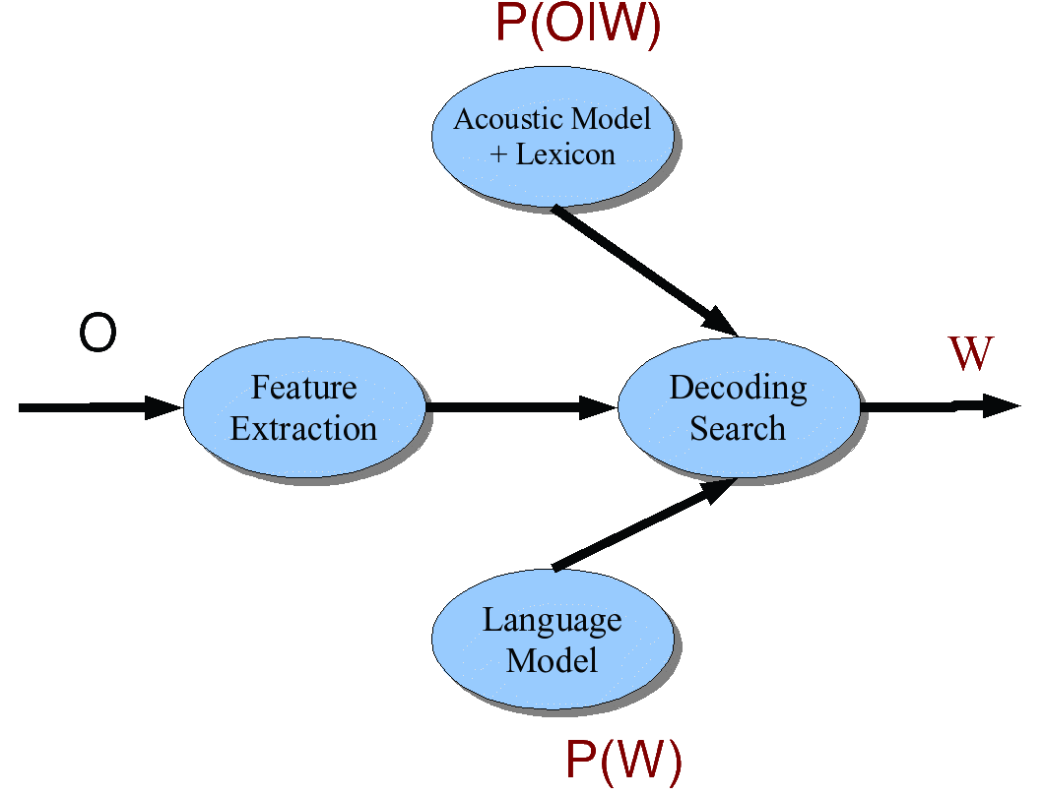
Speech Architecture meets Noisy Channel

Slide 11
Decoding Architecture: five easy pieces
Feature Extraction:
39 “MFCC” features
Acoustic Model:
Gaussians for computing p(o|q)
Lexicon/Pronunciation Model
HMM: what phones can follow each other
Language Model
N-grams for computing p(w_{i}|w_{i-1})
Decoder
Viterbi algorithm: dynamic programming for combining all these to get word sequence from speech

Slide 12
Lexicon
A list of words
Each one with a pronunciation in terms of phones
We get these from on-line pronunciation dictionary
CMU dictionary: 127K words
http://www.speech.cs.cmu.edu/cgi-bin/cmudict
We’ll represent the lexicon as an HMM

Slide 13
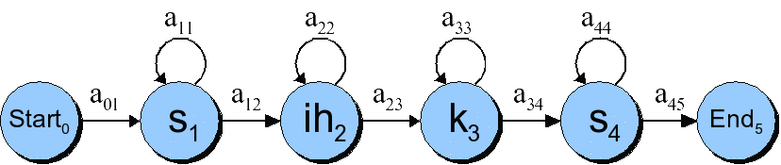
HMMs for speech

Slide 14
Phones are not homogeneous!
ay
k

Slide 15
Each phone has 3 subphones

Slide 16
Resulting HMM word model for “six”

Slide 17
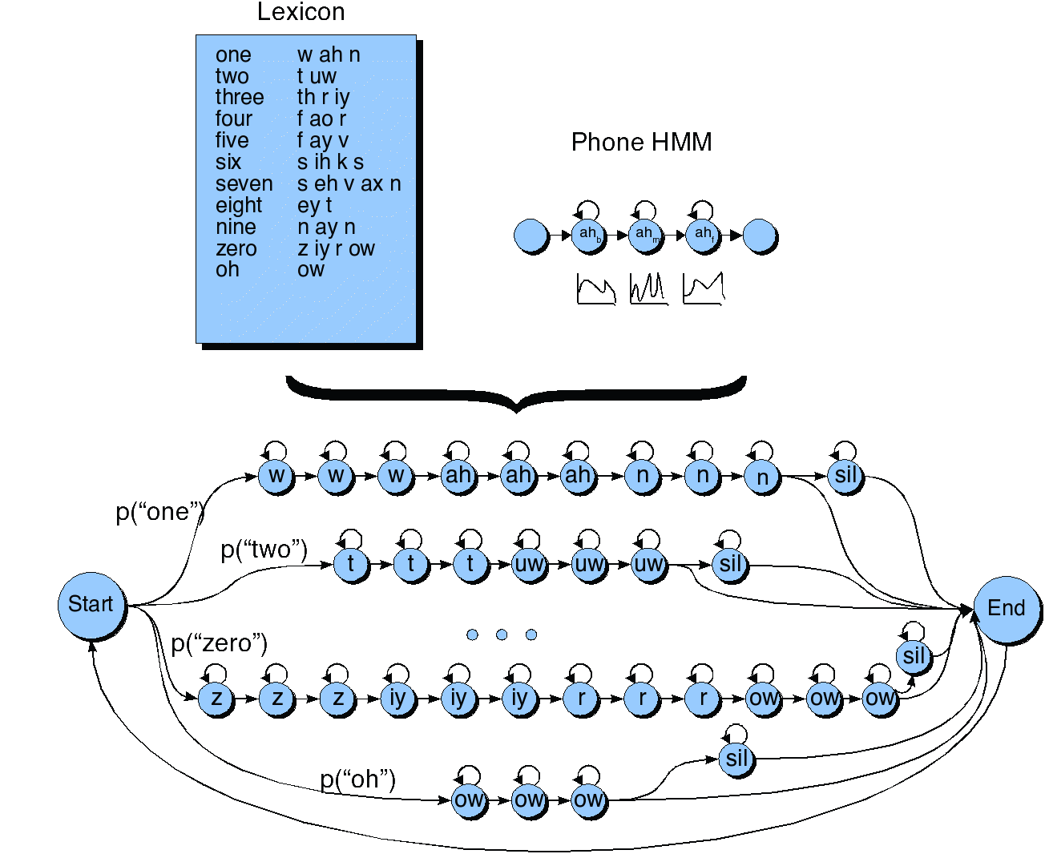
HMM for the digit recognition task

Slide 18
Markov chain for weather

Slide 19
Markov chain for words

Slide 20
Markov chain = First-order observable Markov Model
a set of states
Q = q₁, q₂…q_{N;} the state at time t is q_{t}
Transition probabilities:
a set of probabilities A = a₀₁a₀₂…a_{n1}…a_{nn}.
Each a_{ij} represents the probability of transitioning from state i to state j
The set of these is the transition probability matrix A
Distinguished start and end states

Slide 21
Markov chain = First-order observable Markov Model
Current state only depends on previous state

Slide 22
Another representation for start state
Instead of start state
Special initial probability vector π
An initial distribution over probability of start states
Constraints:

Slide 23
The weather figure using pi

Slide 24
The weather figure: specific example

Slide 25
Markov chain for weather
What is the probability of 4 consecutive warm days?
Sequence is warm-warm-warm-warm
I.e., state sequence is 3-3-3-3
P(3,3,3,3) =
π₃a₃₃a₃₃a₃₃a₃₃ = 0.2 x (0.6)³ = 0.0432

Slide 26
How about?
Hot hot hot hot
Cold hot cold hot
What does the difference in these probabilities tell you about the real world weather info encoded in the figure?

Slide 27
HMM for Ice Cream
You are a climatologist in the year 2799
Studying global warming
You can’t find any records of the weather in Baltimore, MD for summer of 2008
But you find Jason Eisner’s diary
Which lists how many ice-creams Jason ate every date that summer
Our job: figure out how hot it was

Slide 28
Hidden Markov Model
For Markov chains, output symbols = state symbols
See hot weather: we’re in state hot
But not in speech recognition
Output symbols: vectors of acoustics (cepstral features)
Hidden states: phones
So we need an extension!
A Hidden Markov Model is an extension of a Markov chain in which the input symbols are not the same as the states.
This means we don’t know which state we are in.

Slide 29
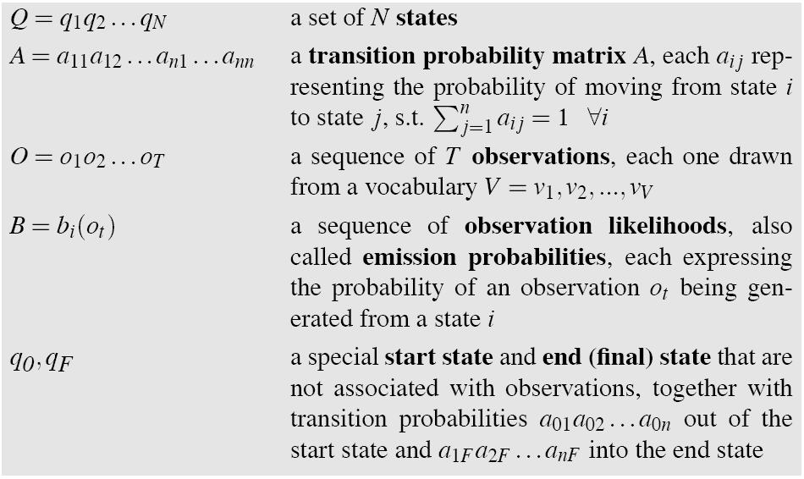
Hidden Markov Models

Slide 30
Assumptions
Markov assumption:
Output-independence assumption

Slide 31
Eisner task
Given
Observed Ice Cream Sequence:
1,2,3,2,2,2,3…
Produce:
Hidden Weather Sequence:
H,C,H,H,H,C…

Slide 32
HMM for ice cream

Slide 33
Different types of HMM structure
Bakis = left-to-right
Ergodic =
fully-connected

Slide 34
The Three Basic Problems for HMMs
Jack Ferguson at IDA in the 1960s
Problem 1 (Evaluation): Given the observation sequence O=(o₁o₂…o_{T}), and an HMM model Φ = (A,B), how do we efficiently compute P(O| Φ), the probability of the observation sequence, given the model?
Problem 2 (Decoding): Given the observation sequence O=(o₁o₂…o_{T}), and an HMM model Φ = (A,B), how do we choose a corresponding state sequence Q=(q₁q₂…q_{T}) that is optimal in some sense (i.e., best explains the observations)?
Problem 3 (Learning): How do we adjust the model parameters Φ = (A,B) to maximize P(O| Φ )?

Slide 35
Problem 1: computing the observation likelihood
Given the following HMM:
How likely is the sequence 3 1 3?

Slide 36
How to compute likelihood
For a Markov chain, we just follow the states 3 1 3 and multiply the probabilities
But for an HMM, we don’t know what the states are!
So let’s start with a simpler situation.
Computing the observation likelihood for a given hidden state sequence
Suppose we knew the weather and wanted to predict how much ice cream Jason would eat.
i.e., P( 3 1 3 | H H C)

Slide 37
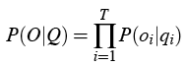
Computing likelihood of 3 1 3 given hidden state sequence

Slide 38
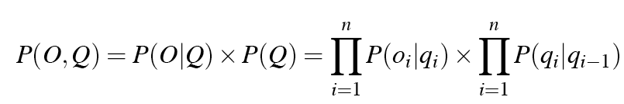
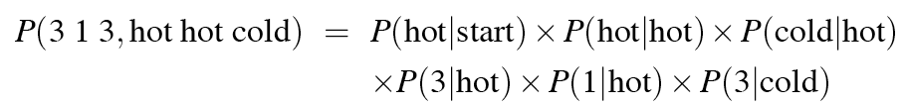
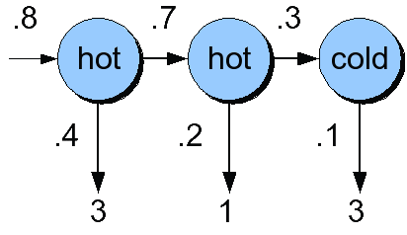
Computing joint probability of observation and state sequence

Slide 39
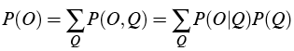
Computing total likelihood of 3 1 3
We would need to sum over
Hot hot cold
Hot hot hot
Hot cold hot
….
How many possible hidden state sequences are there for this sequence?
How about in general for an HMM with N hidden states and a sequence of T observations?
N^{T}
So we can’t just do separate computation for each hidden state sequence.

Slide 40
Instead: the Forward algorithm
A dynamic programming algorithm
Just like Minimum Edit Distance or CKY Parsing
Uses a table to store intermediate values
Idea:
Compute the likelihood of the observation sequence
By summing over all possible hidden state sequences
But doing this efficiently
By folding all the sequences into a single trellis

Slide 41
The forward algorithm
The goal of the forward algorithm is to compute
We’ll do this by recursion

Slide 42
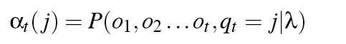
The forward algorithm
Each cell of the forward algorithm trellis alpha_{t}(j)
Represents the probability of being in state j
After seeing the first t observations
Given the automaton
Each cell thus expresses the following probability

Slide 43
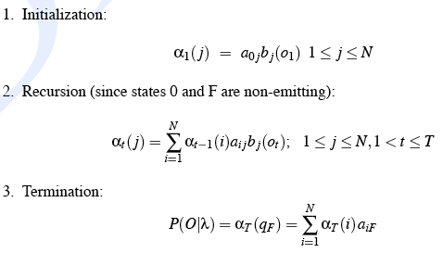
The Forward Recursion

Slide 44
The Forward Trellis
.32*.14+.02*.08=.0464

Slide 45
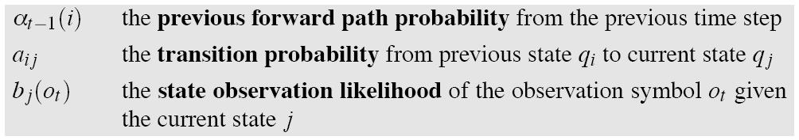
We update each cell

Slide 46
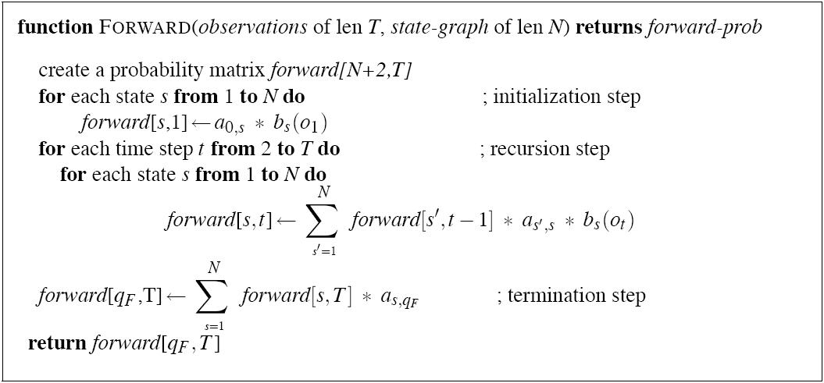
The Forward Algorithm

Slide 47
Decoding
Given an observation sequence
3 1 3
And an HMM
The task of the decoder
To find the best hidden state sequence
Given the observation sequence O=(o₁o₂…o_{T}), and an HMM model Φ = (A,B), how do we choose a corresponding state sequence Q=(q₁q₂…q_{T}) that is optimal in some sense (i.e., best explains the observations)

Slide 48
Decoding
One possibility:
For each hidden state sequence Q
HHH, HHC, HCH,
Compute P(O|Q)
Pick the highest one
Why not?
N^{T}
Instead:
The Viterbi algorithm
Is again a dynamic programming algorithm
Uses a similar trellis to the Forward algorithm

Slide 49
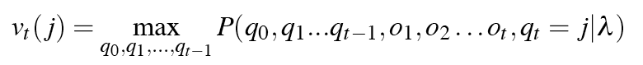
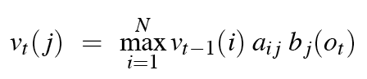
Viterbi intuition
We want to compute the joint probability of the observation sequence together with the best state sequence

Slide 50
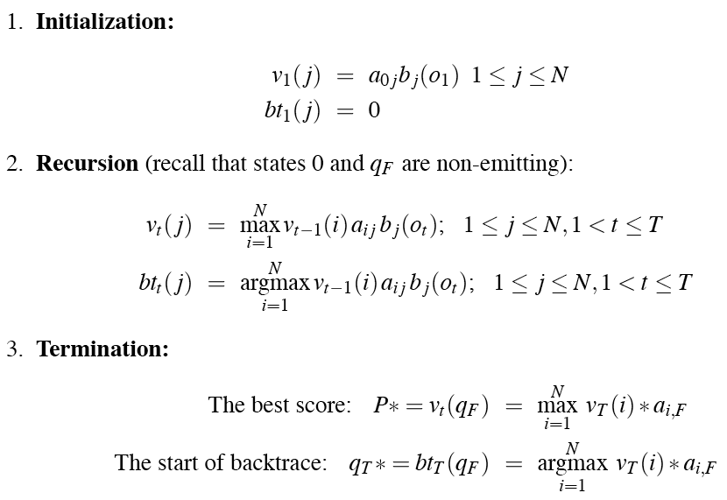
Viterbi Recursion

Slide 51
The Viterbi trellis
/

Slide 52
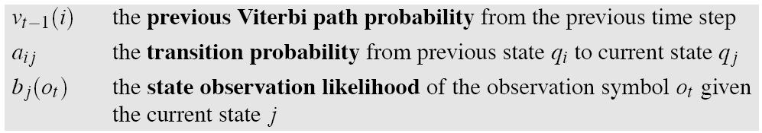
Viterbi intuition
Process observation sequence left to right
Filling out the trellis
Each cell:

Slide 53
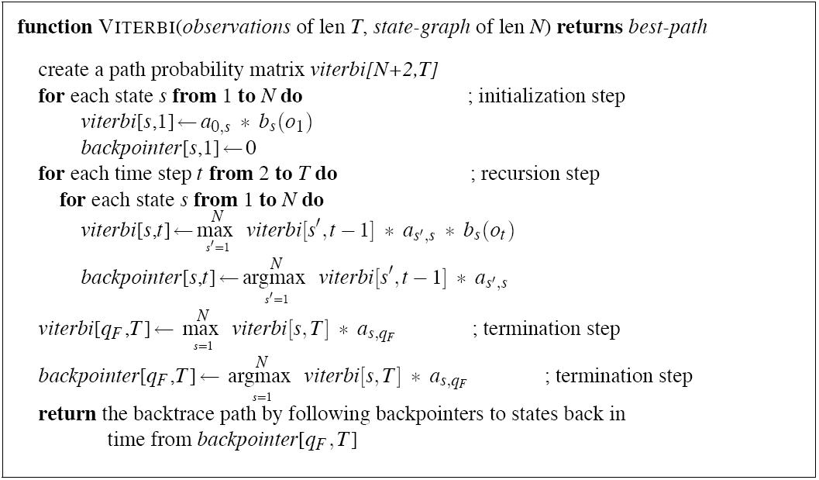
Viterbi Algorithm

Slide 54
Viterbi backtrace
/

Slide 55
HMMs for Speech
We haven’t yet shown how to learn the A and B matrices for HMMs;
we’ll do that on Thursday
The Baum-Welch (Forward-Backward alg)
But let’s return to think about speech

Slide 56
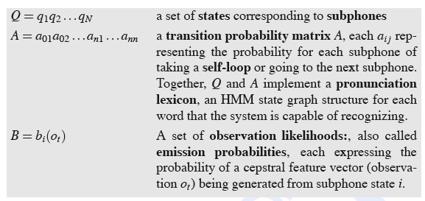
Reminder: a word looks like this:

Slide 57
HMM for digit recognition task

Slide 58
The Evaluation (forward) problem for speech
The observation sequence O is a series of MFCC vectors
The hidden states W are the phones and words
For a given phone/word string W, our job is to evaluate P(O|W)
Intuition: how likely is the input to have been generated by just that word string W?

Slide 59
Evaluation for speech: Summing over all different paths!
f ay ay ay ay v v v v
f f ay ay ay ay v v v
f f f f ay ay ay ay v
f f ay ay ay ay ay ay v
f f ay ay ay ay ay ay ay ay v
f f ay v v v v v v v

Slide 60
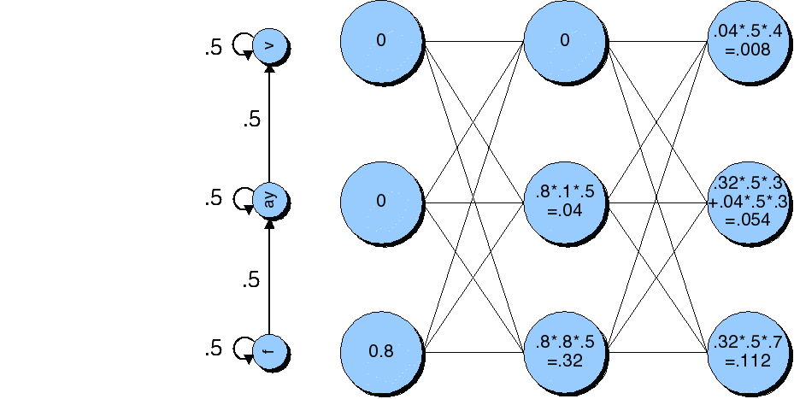
The forward lattice for “five”

Slide 61
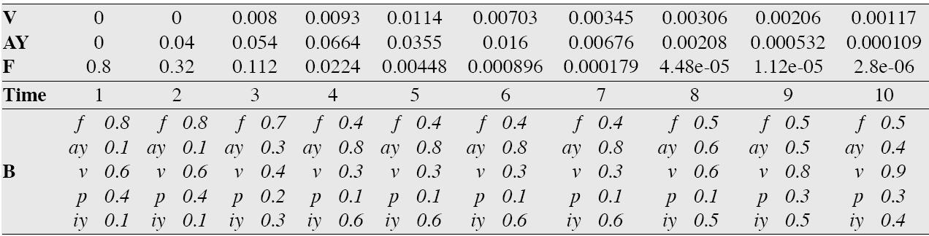
The forward trellis for “five”

Slide 62
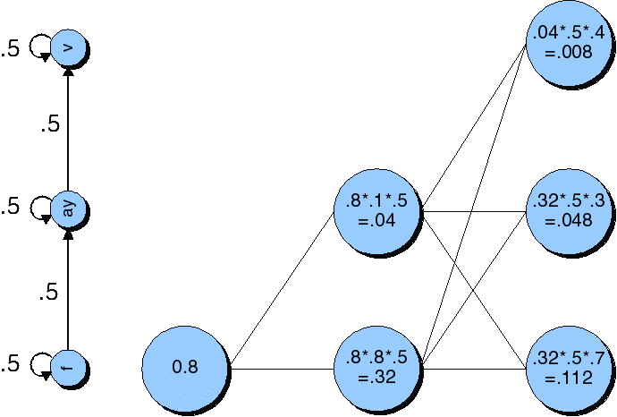
Viterbi trellis for “five”

Slide 63
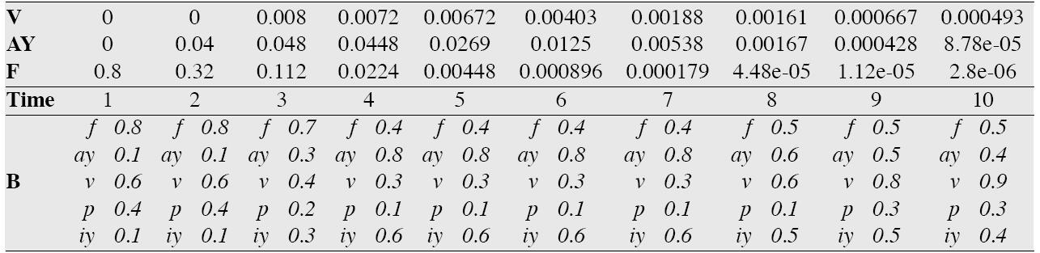
Viterbi trellis for “five”

Slide 64
Search space with bigrams

Slide 65
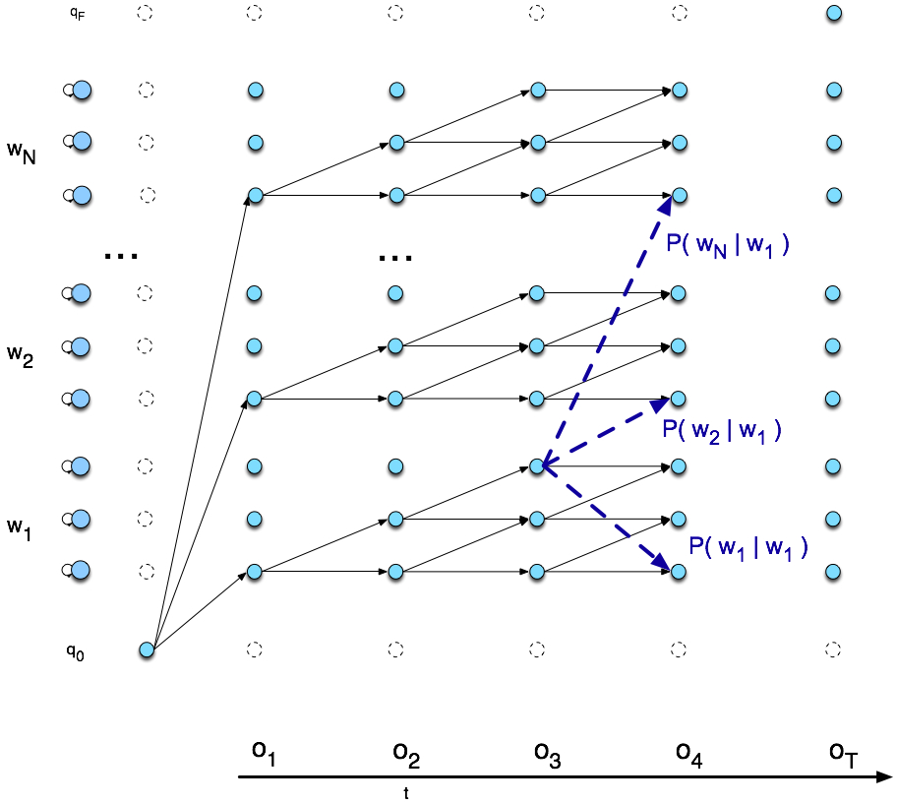
Viterbi trellis

Slide 66
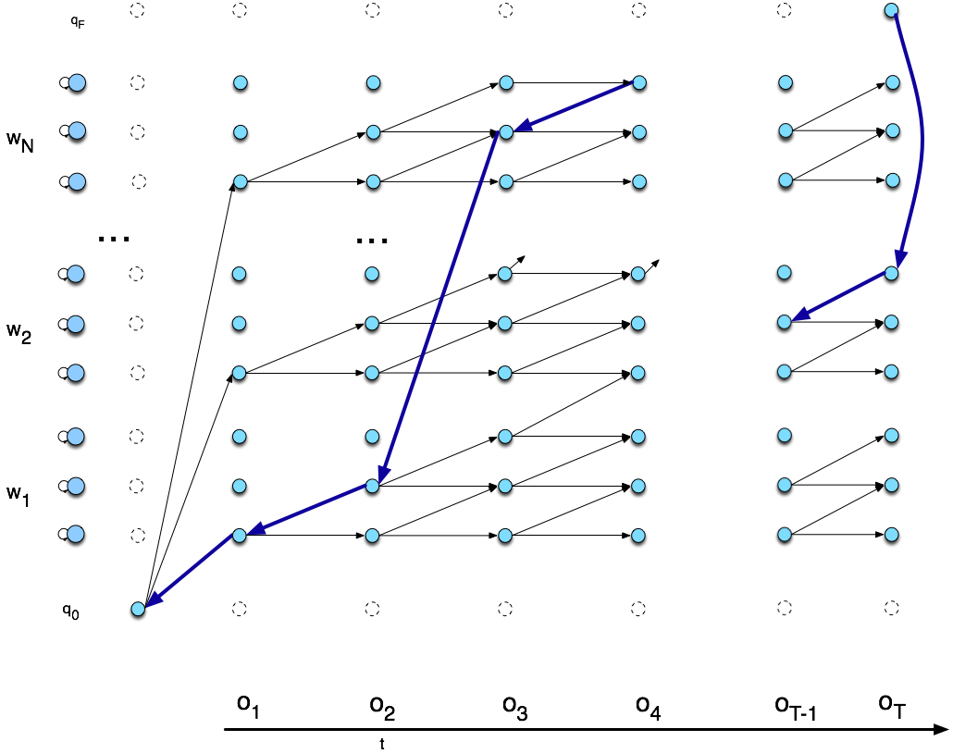
Viterbi backtrace

Slide 67
Summary: ASR Architecture
Five easy pieces: ASR Noisy Channel architecture
Feature Extraction:
39 “MFCC” features
Acoustic Model:
Gaussians for computing p(o|q)
Lexicon/Pronunciation Model
HMM: what phones can follow each other
Language Model
N-grams for computing p(w_{i}|w_{i-1})
Decoder
Viterbi algorithm: dynamic programming for combining all these to get word sequence from speech

